Slide 1
Simulated Pathfinding and 3D Visualization
Isaac C Ellis
Advisor: Dr. Arvin Agah
April something, 2001

Slide 2
Topics of Discussion
Motivation
Areas of Exploration
Implementation
Conclusions
Demonstration

Slide 3
Motivation
Wanted to do more AI research
Chose to apply it to Departmental Honors to make sure I actually followed through
Needed a demo application for job search

Slide 4
Areas of Exploration
Artificial Intelligence
3D Graphics
Software Engineering Techniques

Slide 5
Artificial Intelligence
Path Planning
  Implementing and testing various search methods
    Depth First, Breadth First, Greedy, A*
    Looked at usefulness of blind search vs. heuristic search
    Compared methods of heuristic search
    Used search methods in different types of search spaces

Slide 6
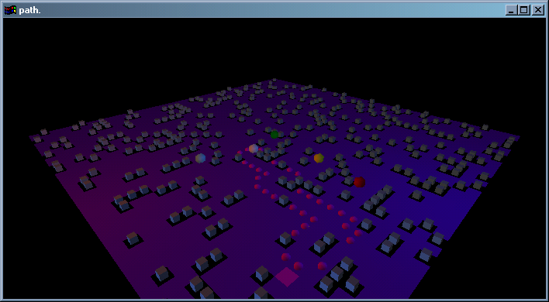
Artificial Intelligence
Finding Paths through Obstacles

Slide 7
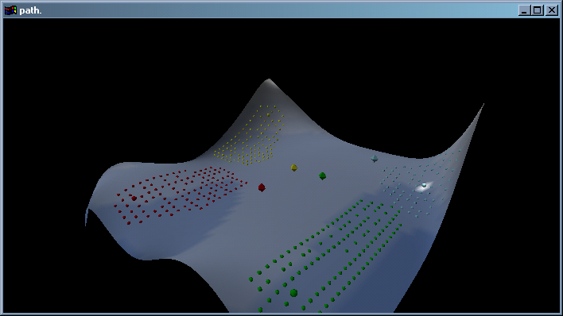
Artificial Intelligence
Artificial Intelligence
Finding Optimal Paths on 3D Terrain

Slide 8
3D Graphics
Implemented a Beziér Surface Terrain System
  Terrain defined mathematically with an array of control points
  Terrain vertices defined by interpolating between the control points using the Bernstein Polynomial Basis Functions
  Code can generate surfaces of any order, but demo terrain consists of a 7th order by 7th order patch

Slide 9

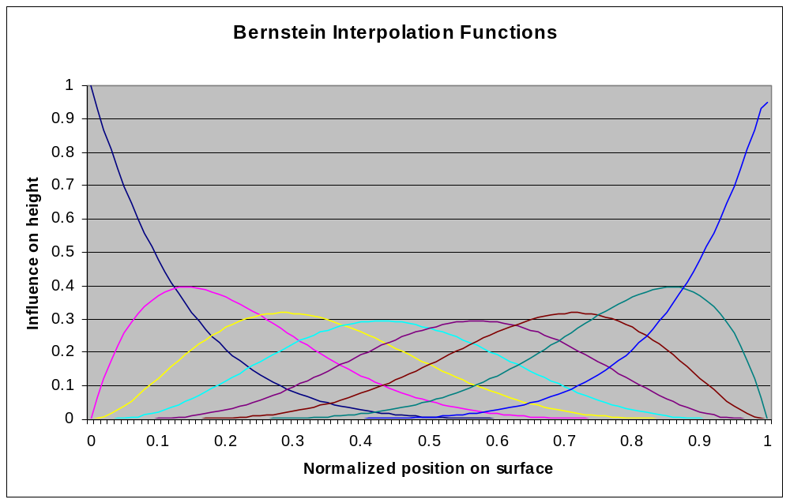
3D Graphics
n = Order of system, i = 0, 1, … , n

Slide 10
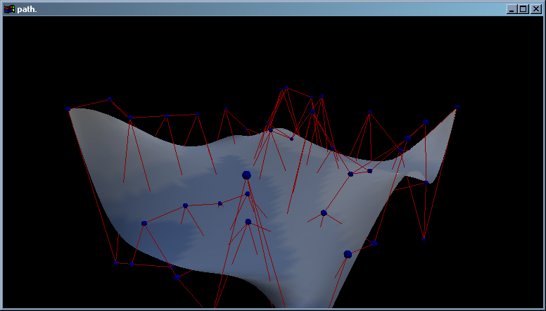
3D Graphics
Beziér Surface with Control Point Mesh Displayed

Slide 11
Software Engineering
Using the C++ Standard Library
  Language was not standardized until 1997
  Standard includes a comprehensive library of utilities, storage containers, and functions to handle them
  Also includes the Standard Template Library(STL) for generic programming
  Projects make extensive use of STL

Slide 12
Software Engineering
Combining Object Oriented and Functional styles of architecture
  Generic programming brings in LISP/Scheme approach to programming
  Function Objects allow C++ to behave like a Functional langauge

Slide 13
Software Engineering
Scheme
(define (general-search searchspace queueingfunc expansionfunc expandednodes currentnode goal)
(define (recurse expandednodes currentnode)
(if (eq? (car expandednodes) goal) (car expandednodes)
(general-search (queueingfunc (expansionfunc currentnode searchspace) expandednodes)))))
(recurse '() (car searchspace)))
C++
NodeType & Search( FunctionObject &Queueing, FunctionObject &Expand, vector<char> worldMap ) {
list<NodeType> expandedNodes;
while( currentNode != Goal ) {
Queueing( expandedNodes, Expand( currentNode, worldMap );
currentNode = expandedNodes.pop_front();
}
return currentNode;
}

Slide 14
Conclusions and Results
AI- Created several searches and applied them to different types of search spaces
3D Graphics- Created a Beziér surface terrain system that allows for surfaces of unlimited complexity (most only allow bicubic surfaces)
Software Engineering- Learned the STL and used it in conjunction with OOP to write generic algorithms
Got a job!

Slide 15
Future Work
Many heuristic searches could be examined
Place obstacles on 3D terrain
Animate agents so movement is smooth and rate depends on slope of terrain

